Slide 1
Knowledge Based System
Lecture #09
Dr. Md. Hasanuzzaman
Assistant Professor
Department of Computer Science & Engineering
Dhaka University
Knowledge-Based System, Lecturer #09

Slide 2
Contents
Genetic Algorithms
Keywords Related to GA
Basic Steps of Genetic Algorithm
Example Problem & Solution By Genetic Algorithm
Knowledge-Based System, Lecturer #09

Slide 3
Genetic Algorithms
A type of evolutionary computation inspired by Darwin’s theory of evolution.
A genetic algorithm generates a population of possible solutions encoded as chromosomes, evaluates their fitness, and create a new population by applying genetic operators-crossover and mutation.
By repeating this process over many generations, the genetic algorithm breeds an optimal solution to the problem.
Knowledge-Based System, Lecturer #09

Slide 4
Key-Words Related to GA
Gene:A basic unit of chromosome that controls the development of a particular feature of a living organism. In Holland’s (Founder of GA) Chromosome a gene is represented by either 0 or 1.
Chromosomes: A string of genes that represent an individual. Each chromosome consists of a number of gene.
Fitness: The ability of a living organism to survive and reproduce in a specific environment.
Crossover: A reproduction operator that creates a new chromosome by exchanging parts of two existing chromosome.
Mutation: A genetic operator that randomly change the gene value in a chromosome.
Knowledge-Based System, Lecturer #09

Slide 5
Keywords Related to GA (cont.)
Fitness Function: A mathematical function used for calculating the fitness of a chromosome.
Crossover Probability: A number between zero and one that indicates the probability of two chromosomes crossing over.
Mutation Probability: A number between zero and one that indicates the probability of mutation occurring in a single gene.
Offspring: An individual that was produced through reproduction. It also referred to as child.
Population: A group of individuals that breed together.
Knowledge-Based System, Lecturer #09

Slide 6
Basic Steps of Genetic Algorithm
Start
Select a pair of chromosomes for mating
With the crossover probability p_{c} exchange
part of the two selected chromosomes and
select two offspring
Generate a population of
chromosomes of size N:
x₁, x₂, ……, x_{N}
With the mutation probability p_{m} randomly
change the gene Values in the two offspring
chromosomes
Calculate the fitness of
each chromosome:
f(x₁), f(x₂), ……, f(x_{N})
Place the resulting chromosomes
in the new population
No
Termination?
No
Size of Population
equal to N?
Yes
Yes
Stop
Replace the current chromosome population
with the new population
Knowledge-Based System, Lecturer #09

Slide 7
Example Problem & Solution
Find the maximum value of the function (15x-x²), where parameter x varies between 0 and 15.
  Chromosome can be built with only four gene (0-15)
Solution:
Suppose,
  The size of the chromosome population N is 6.
  The crossover probability pc=0.7
  The mutation probability=0.001
  The fitness function=f(x)=15x-x²
Knowledge-Based System, Lecturer #09

Slide 8
Example Problem & Solution
Step 1: GA creates an initial population of chromosomes by filling six 4-bit string with randomly generated ones and zeros
Chromosome Label | Chromosome String | Decoded Integer | Chromosome Fitness | Fitness Ratio
X1 | 1100 | 12 | 36 | 16.51
X2 | 0100 | 4 | 44 | 20.18
X3 | 0001 | 1 | 14 | 6.42
X4 | 1110 | 14 | 14 | 6.422
X5 | 0111 | 7 | 56 | 25.68
X6 | 1001 | 9 | 54 | 24.77
Knowledge-Based System, Lecturer #09

Slide 9
Example Problem & Solution
Step 2: Calculate the fitness of each individual Chromosome
Chromosome Label | Chromosome String | Decoded Integer | Chromosome Fitness | Fitness Ratio
X1 | 1100 | 12 | 36 | 16.51
X2 | 0100 | 4 | 44 | 20.18
X3 | 0001 | 1 | 14 | 6.42
X4 | 1110 | 14 | 14 | 6.422
X5 | 0111 | 7 | 56 | 25.68
X6 | 1001 | 9 | 54 | 24.77
Knowledge-Based System, Lecturer #09

Slide 10
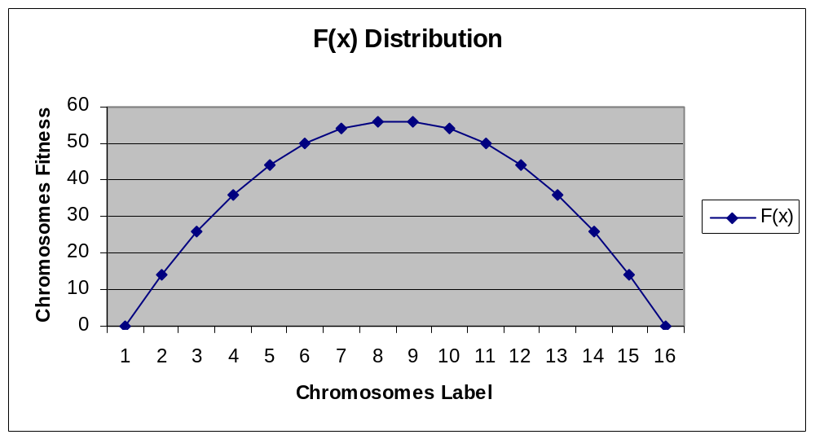
Fitness Function and Chromosome Locations
.
.
.
.
.
.
Knowledge-Based System, Lecturer #09

Slide 11
Example Problem & Solution
Step 3:The fitness ratio determines the chromosome’s chance of being selected for mating.
X5 & X6 have fair chance; X3 & X4 have less chance.
Chromosome Label | Chromosome String | Decoded Integer | Chromosome Fitness | Fitness Ratio
X1 | 1100 | 12 | 36 | 16.51
X2 | 0100 | 4 | 44 | 20.18
X3 | 0001 | 1 | 14 | 6.42
X4 | 1110 | 14 | 14 | 6.42
X5 | 0111 | 7 | 56 | 25.68
X6 | 1001 | 9 | 54 | 24.77
Knowledge-Based System, Lecturer #09

Slide 12
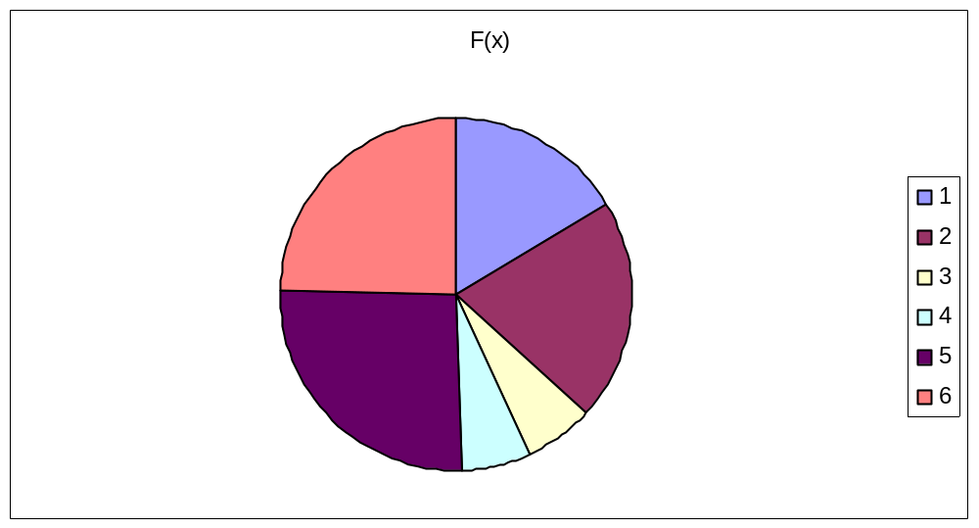
Fitness Function in Roulette Wheel Distribution
1100 (12)=36
0100 (4)=44
0001 (1)=14
1110 (14)=14
0111 (7)=56
1001 (9)=54
Knowledge-Based System, Lecturer #09

Slide 13
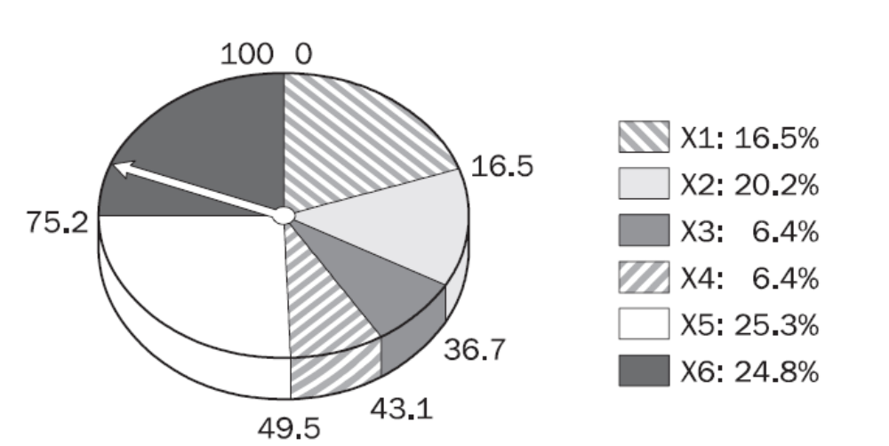
Fitness Function in Roulette Wheel Distribution
1100 (12)=36
0100 (4)=44
0001 (1)=14
1110 (14)=14
0111 (7)=56
1001 (9)=54
Knowledge-Based System, Lecturer #09

Slide 14
Example Problem & Solution
(Mating)
Step 4: Selected chromosome for mating.
First X6 & X2 become parents, 2nd X1 & X5, then X2 & X5.
Generation i |  | Crossover | Mutation
Chromosome Label | Chromosome String
X1_{i} | 1100 |  | X6`_{i} 1000
X2_{i} | 0100 |  | X2`_{i} 0101
X3_{i} | 0001 |  | X1`_{i} 1111, X1``_{i} 1011
X4_{i} | 1110 |  | X5`_{i} 0100
X5_{i} | 0111 |  | X2`_{i} 0100, X2``_{i} 0110
X6_{i} | 1001 |  | X5`_{i} 0111
X6_{i} 10-01
X2_{i} 01-00
X1_{i} 11-00
X5_{i} 01-11
X2_{i} 01-00
X5_{i} 01-11
Knowledge-Based System, Lecturer #09

Slide 15
Example Problem & Solution
(Crossover)
Step 5: Crossover Operator randomly chooses a crossover point where two parent chromosomes ‘Break’ and then exchange the chromosomes after that point.
Generation i |  | Crossover | Mutation
Chromosome Label | Chromosome String
X1_{i} | 1100 |  | X6`_{i} 1000
X2_{i} | 0100 |  | X2`_{i} 0101
X3_{i} | 0001 |  | X1`_{i} 1111, X1``_{i} 1011
X4_{i} | 1110 |  | X5`_{i} 0100
X5_{i} | 0111 |  | X2`_{i} 0100, X2``_{i} 0110
X6_{i} | 1001 |  | X5`_{i} 0111
X6_{i} 10-01
X2_{i} 01-00
X1_{i} 11-00
X5_{i} 01-11
X2_{i} 01-00
X5_{i} 01-11
Knowledge-Based System, Lecturer #09

Slide 16
Example Problem & Solution
(Crossover)
Step 5: If a pair of chromosomes does not cross over then chromosome cloning take places and the offspring are exact copies of each parent.
Generation i |  | Crossover | Mutation
Chromosome Label | Chromosome String
X1_{i} | 1100 |  | X6`_{i} 1000
X2_{i} | 0100 |  | X2`_{i} 0101
X3_{i} | 0001 |  | X1`_{i} 1111, X1``_{i} 1011
X4_{i} | 1110 |  | X5`_{i} 0100
X5_{i} | 0111 |  | X2`_{i} 0100, X2``_{i} 0110
X6_{i} | 1001 |  | X5`_{i} 0111
X6_{i} 10-01
X2_{i} 01-00
X1_{i} 11-00
X5_{i} 01-11
X2_{i} 01-00
X5_{i} 01-11
Knowledge-Based System, Lecturer #09

Slide 17
Example Problem & Solution
(Mutation)
Step 6: The mutation operator flips a randomly selected gene in a chromosome.
Generation i |  | Crossover | Mutation
Chromosome Label | Chromosome String
X1_{i} | 1100 |  | X6`_{i} 1000
X2_{i} | 0100 |  | X2`_{i} 0101
X3_{i} | 0001 |  | X1`_{i} 1111, X1``_{i} 1011
X4_{i} | 1110 |  | X5`_{i} 0100
X5_{i} | 0111 |  | X2`_{i} 0100, X2``_{i} 0110
X6_{i} | 1001 |  | X5`_{i} 0111
X6_{i} 10-01
X2_{i} 01-00
X1_{i} 11-00
X5_{i} 01-11
X2_{i} 01-00
X5_{i} 01-11
Knowledge-Based System, Lecturer #09

Slide 18
Example Problem & Solution
Step 7:The fitness ratio determines the chromosome’s chance of being selected for mating.
X5 & X6 have fair chance; X3 & X4 have less chance.
Generation i |  | Generation i+1
Chromosome Label | Chromosome String | Chromosome Label | Chromosome String | Fitness
X1_{i} | 1100 | X1_{i+1} | 1000 | 56
X2_{i} | 0100 | X2_{i+1} | 0101 | 50
X3_{i} | 0001 | X3_{i+1} | 1011 | 44
X4_{i} | 1110 | X4_{i+1} | 0100 | 44
X5_{i} | 0111 | X5_{i+1} | 0110 | 54
X6_{i} | 1001 | X6_{i+1} | 0111 | 56
Knowledge-Based System, Lecturer #09

Slide 19
Fitness Function and Chromosome Locations
.
.
Knowledge-Based System, Lecturer #09

Slide 20
Recommended Textbooks
[Negnevitsky, 2001] M. Negnevitsky “ Artificial Intelligence: A guide to Intelligent Systems”, Pearson Education Limited, England, 2002. (Chapter 7, page 238-250)
[Russel, 2003] S. Russell and P. Norvig Artificial Intelligence: A Modern Approach Prentice Hall, 2003, Second Edition
[Patterson, 1990] D. W. Patterson, “Introduction to Artificial Intelligence and Expert Systems”, Prentice-Hall Inc., Englewood Cliffs, N.J, USA, 1990.
[Lindsay, 1997] P. H. Lindsay and D. A. Norman, Human Information Processing: An Introduction to Psychology, Academic Press, 1977.
Knowledge-Based System, Lecturer #09

Slide 21
End of Presentation
Question/Suggestions?
Thanks to all !!!
Knowledge-Based System, Lecturer #09

